Slide 1

Waste and Reuse
Melissa W., Disney V., Igor B., Miles M.
Icons from https://thenounproject.com/
Doodles from OpenDoodles.com

Slide 2

Initial POV
New Interviews
Brainstorming
Experience Prototypes
Summary

Slide 3

We met Kimberly, a sustainably-minded adult whose work often involves environmentalism.
We were amazed to realize that Kimberly shopped almost exclusively at thrift stores while she was in college (despite being able to afford buying items new) but now only thrifts rarely as an adult—as if it somehow became inconvenient and socially unacceptable.
It would be game-changing to make thrifting more accessible and appealing to adults and college students alike.

Slide 4

4
more interviews

Slide 5




Michelle
Olivia
Alice
Kathryn

Slide 6

3
experience
prototypes

Slide 7



Vlad
Isabelle
Grace

Slide 8
Kathryn
IT Department Analyst
“It can be expensive to shift everything in my life to zero-waste at once.”
“No one is ready to be 100% zero waste right away. But it’s about trying to figure out the simple things I can start shifting.”
Overwhelmed with options to minimize waste.
“With shoes you have a better time of finding without trying them on because you know what size your feet are.”
Often afraid to purchase items without trying them on first.
Struggles to find quick and convenient solutions for sustainable life choices.

Slide 9
Alice
User experience researcher
“[I like] buying an item that has history beyond my own, that has had a life before my own.”
She prefers buying used items to new items because of their unique histories.
Alice has purchased items secondhand and sold them third hand when she no longer needs them.
Items can have several owners during their feasible lifespan.
“[I feel] wasteful all the time.”
She is ashamed of how wasteful she is.

Slide 10
Michelle
U.S. college student from Hong Kong
“Shipping used items isn’t a thing here [in HK]. I just meet up at a local train station to exchange items.”
She is comfortable meeting people to exchange items.
“We often give our stuff away to relatives if they need it.”
“My parents think buying used clothes is unlucky.”
Her family owns items they’re willing to give away if asked.
She worries buying used will violate her family’s cultural norms.

Slide 11
Olivia
U.S. college student
“I’m never super excited about sustainability specifically, but I do get very excited when I find good deals.”
“My parents are very against me thrifting. They have a weird thing about me wearing old clothes when I don’t have to. It might be an immigrant thing.”
Her parents are embarrassed about her wearing other people’s clothes, and—as immigrants—are proud that they can afford to buy her new ones.
She deeply values good deals; sustainability is just an added upside.

Slide 12

POVs

Slide 13
We met
Michelle, a Hong Kong student who goes to college in the United States.
Notes:
HMW eliminate the need to ship used items altogether?
HMW encourage local pickups and exchanges?
HMW increase the number of items per shipment?
HMW make face-to-face exchanges safer?
HMW make face-to-face exchanges more convenient?
HMW make local pickups faster and less time consuming than shipping?
HMW make the U.S. smaller?
HMW make the U.S. more like Hong Kong?
HMW remove the need to buy used items from others?
HMW build well-stocked local trading economies?
HMW make local pickups more like shipping?
HMW make buying items from far away unnecessary?
HMW make shipping sustainable?
HMW adjust expectations so that local pickups are the default?

Slide 14
We were amazed to realize
that Michelle thinks shipping used items is “weird,” both at home and in the U.S.: Hong Kong is so small that local pickups are the norm.

Slide 15
It would be game-changing
to bring Hong Kong’s hyper-local reselling model to other parts of the world.

Slide 16
We met
Olivia, a Chinese-American college student who lives in Chicago and is passionate about fashion.
Notes:
HMW make used items more like new items?
HMW make new items more like used items, making it all the same?
HMW repackage thrifting so her parents find it acceptable?
HMW make thrifting cleaner?
HMW make the parental stigma the most exciting part of thrifting?
HMW get parents involved in thrifting themselves?
HMW make thrifting directly benefit the parents?
HMW make thrifting more trendy?
HMW make thrifting feel like an ecological necessity?
HMW eliminate parents?
HMW help people care less about what other people think about them thrifting?
HMW make thrifting anonymous?
HMW make other people less judgemental about thrifting?

Slide 17
We were amazed to realize
that despite her interest in fashion and buying second-hand, she avoids thrifting because her parents disapprove of it—they view it as unnecessary and dirty, especially considering that they can buy her new clothes.

Slide 18
It would be game-changing
to destigmatize thrifting in the eyes of her parents.

Slide 19

We met
Dan, a semi-professional dumpster diver who hasn’t bought groceries since October, and bought a deep freezer to store goods through next Winter.
Notes:
HMW redistribute grocery store waste that is still usable?
HMW bring awareness to the durability and shelf life of products?
HMW help grocery stores not order too much?
HMW increase the durability or shelf life of items?
HMW repurpose excess items into other new products?
HMW ensure grocery stores always have room for excess items?
HMW make sure everything gets bought before it’s thrown away?
HMW make dumpster diving an in-store sanctioned activity?
HMW make excess inventory more valuable?
HMW encourage consumers to buy items about to be thrown out?
HMW eliminate surplus inventory?
HMW make waste more useful?
HMW make dumpsters more like store shelves and bring them into the store?

Slide 20
We were amazed to realize
that most of what Dan finds in dumpsters is practically new, and is only thrown away to make room for new items on the shelves.

Slide 21
It would be game-changing
if grocery stores had alternative ways to dispose of items that didn’t involve the dumpster.

Slide 22

How might we...?

Slide 23
How might we make buying items from far away unnecessary?
We met Michelle, a Hong Kong student who goes to college in the United States. We were amazed to realize that Michelle thinks shipping used items is “weird,” both at home and abroad: Hong Kong is so small that local pickups are the norm. It would be game-changing to bring Hong Kong’s hyper-local reselling model to other parts of the world.

Slide 24
How might we repackage thrifting so (her) parents find it acceptable?
We met Olivia, a Chinese-American college student who lives in Chicago and is passionate about fashion. We were amazed to realize that despite her interest in fashion and buying second-hand, she avoids thrifting because her parents disapprove of it—they view it as unnecessary and dirty, especially considering that they can buy her new clothes. It would be game-changing to destigmatize thrifting in the eyes of her parents.

Slide 25
How might we make sure everything gets bought before it’s thrown away?
We met Dan, a semi-professional dumpster diver who hasn’t bought groceries since October, and bought a deep freezer to store goods through next Winter. We were amazed to realize that most of what Dan finds in dumpsters is practically new, and is only thrown away to make room for new items on the shelves. It would be game-changing if grocery stores had alternative ways to dispose of items that didn’t involve the dumpster.

Slide 26

Solutions

Slide 27
Lots of ideas...
Pokemon GO but for thrifting; instead of gyms there are locations one can thrift items.
Teleportation system where you can scan items and spawn them elsewhere.
People who throw old items at people.
Pulley system through neighborhoods to exchange goods locally.
“Dumpsters—but, like, free. Free-sters. In the store.”
Make it impossible to skip YouTube ads for thrifting stores.

Slide 28
HMW make sure everything gets bought before it’s thrown away?
An app that enables consumers to buy grocery stores’ soon-expiring items at a discounted price—or even for free.

Slide 29
An app that enables consumers to buy grocery stores’ soon-expiring items at a discounted price—or even for free.
Assumption
consumers are willing to buy older items if it means getting a great deal.

Slide 30
An app that enables consumers to buy grocery stores’ soon-expiring items at a discounted price—or even for free.
We wanted to know
whether people would choose older items
We built
a Google Form survey to test consumers’ comfort levels and preferences.

Slide 31
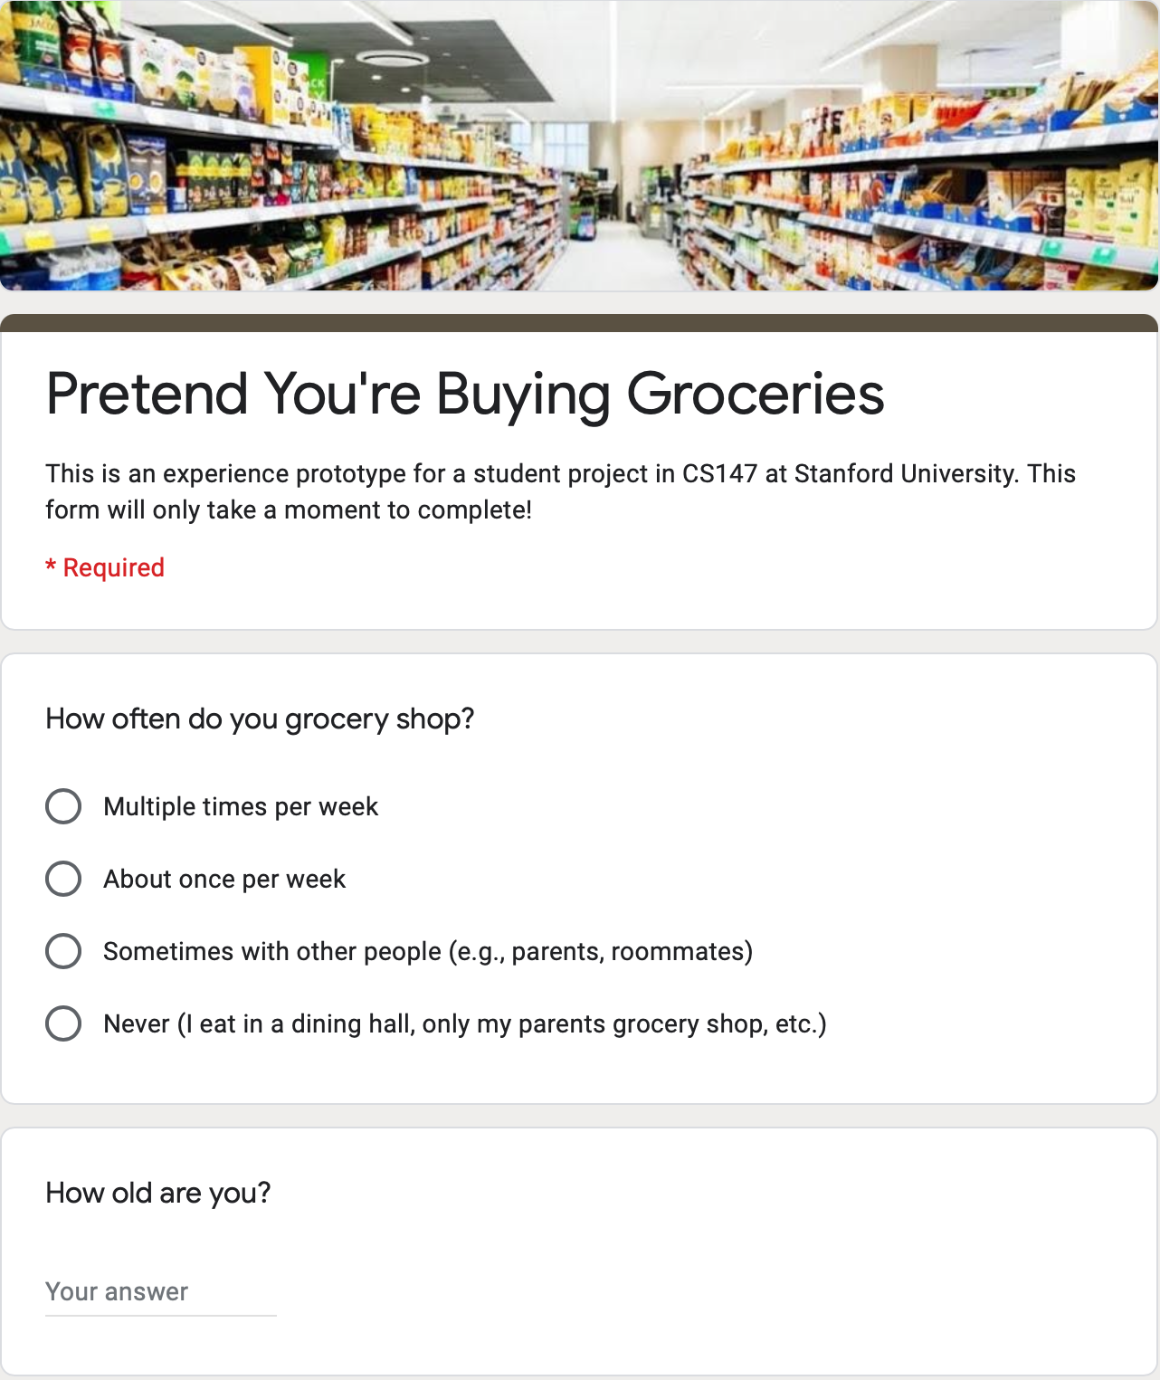
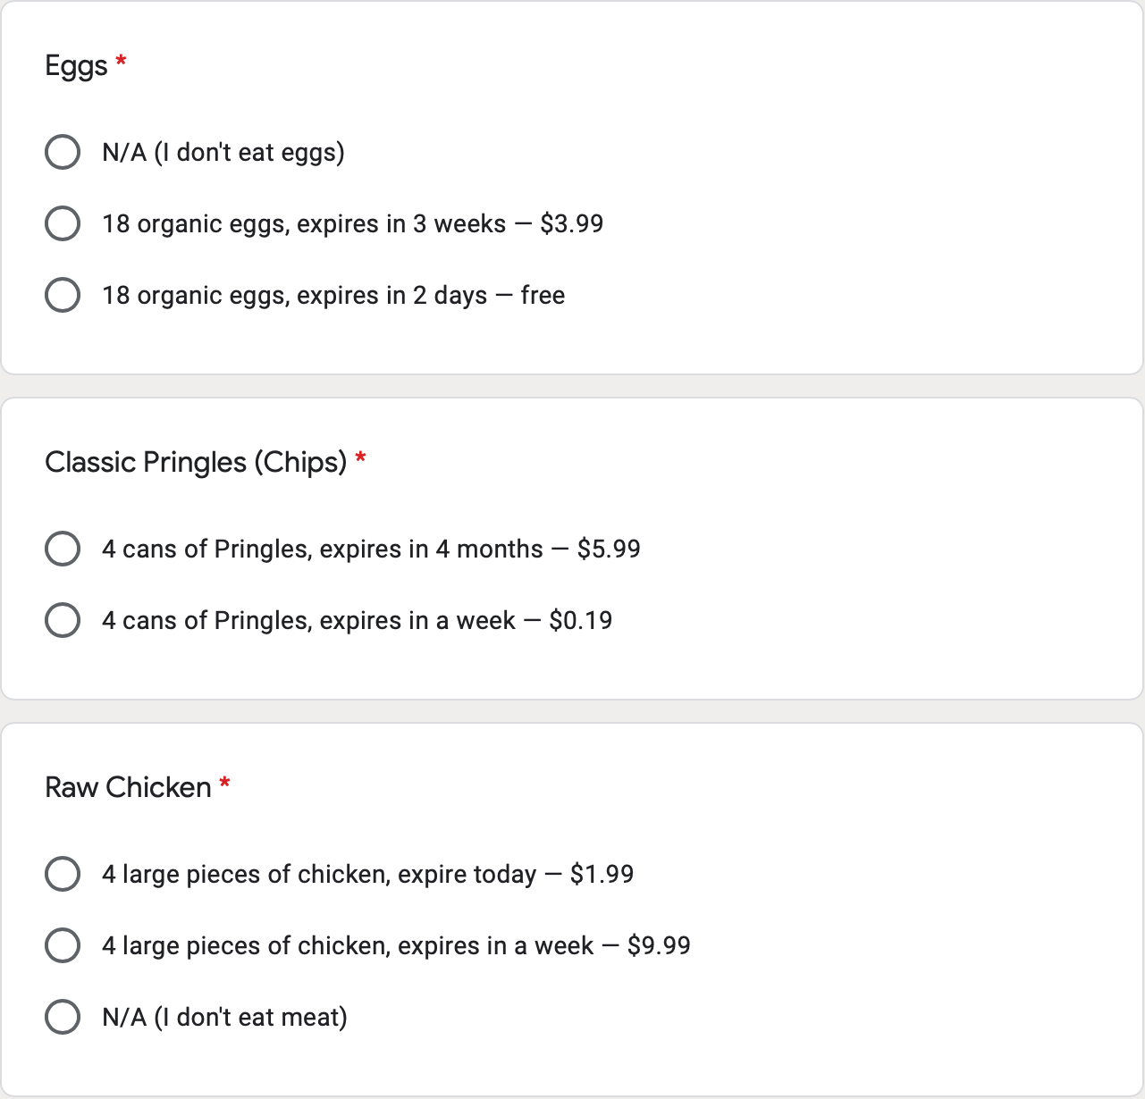

Slide 32
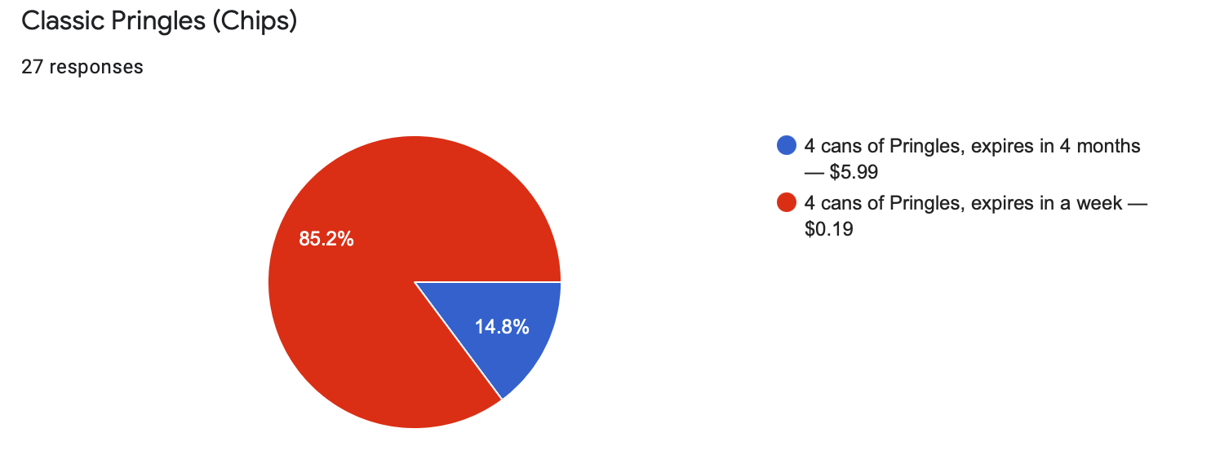

Slide 33
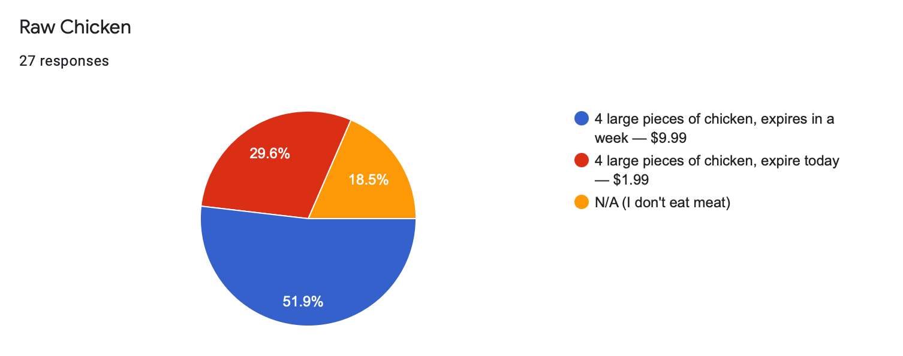

Slide 34
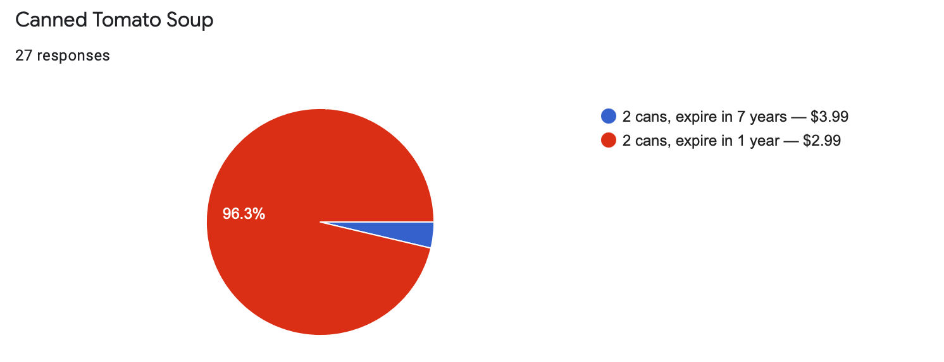
(1 year may seem like a lot, but Dan saw this happen!)

Slide 35
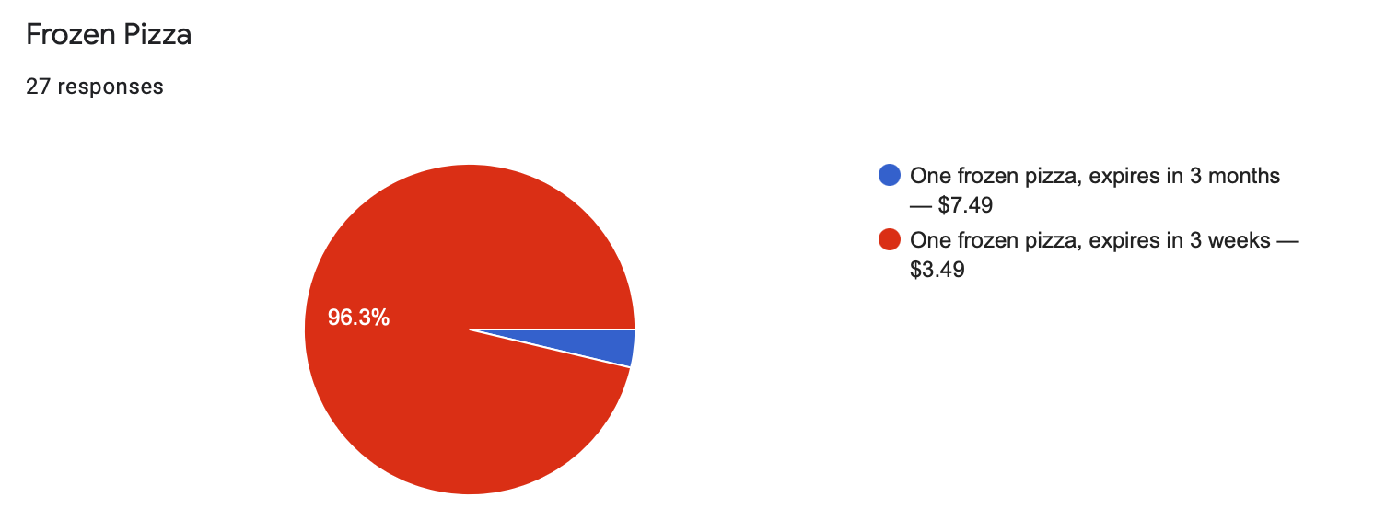

Slide 36
Vlad
An active baker
“[If the price was the same], I would choose the product that has more shelf life left.”
“Chips don’t expire.”

Slide 37
What worked
People overwhelmingly chose the older, cheaper item.
What didn’t work
Few chose to buy older produce, meats, and dairy.
Surprises
There were no items where people overwhelmingly chose to buy the newer item.
New learnings
For some discerning chefs, items go bad even before they technically expire (e.g., a baker’s eggs).

Slide 38
Assumptions validated
Most respondents were willing to buy older items if there was a discount.
Smaller discounts pushed respondents toward the newer items—discounts matter!
New
assumptions
Grocery stores would be willing to sell items at the prices we evaluated.
Expiration dates are the main criteria for discounts (some items have no listed expiration date, like produce).

Slide 39
HMW make buying items from far away unnecessary?
A reverse marketplace for college campuses, where buyers post what they need and potential sellers respond—no shipping required.

Slide 40
A reverse marketplace for college campuses, where buyers post what they need and potential sellers respond—no shipping required.
Assumption
people would be willing to sell certain items if they had a buyer, even if they weren’t originally planning on selling it.

Slide 41
A reverse marketplace for college campuses, where buyers post what they need and potential sellers respond—no shipping required.
We wanted to know
whether people would sell items if someone asked
We set up
a group text scenario to evaluate just that

Slide 42
The premise
Miles posted that he needed a copy of “Make Russia Great Again,” and Grace responded because she has a copy.

Slide 43
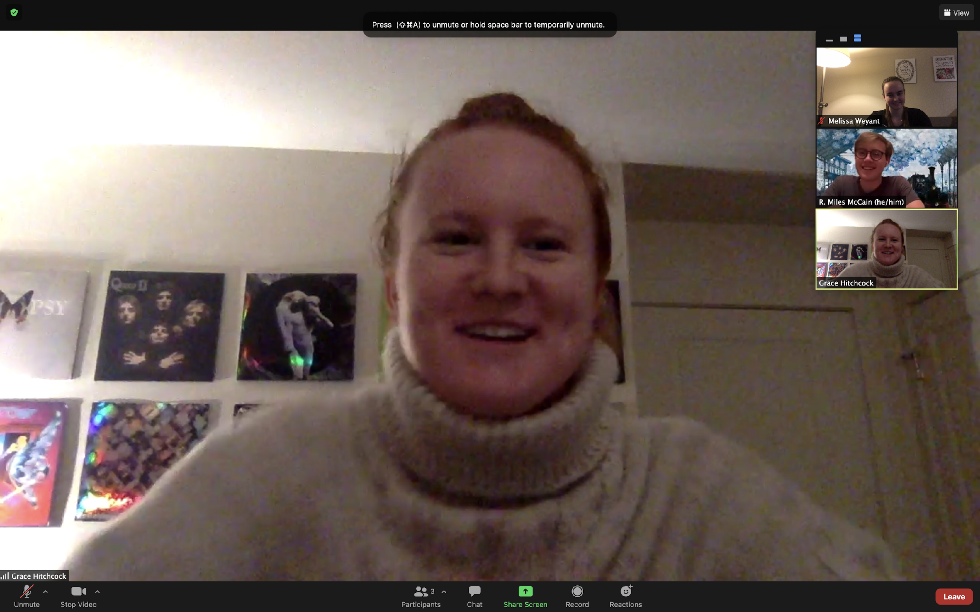
Meet Grace, who owns a copy of Make Russia Great Again” — the book Miles wants to purchase. They are about to be connected via text message!

Slide 44
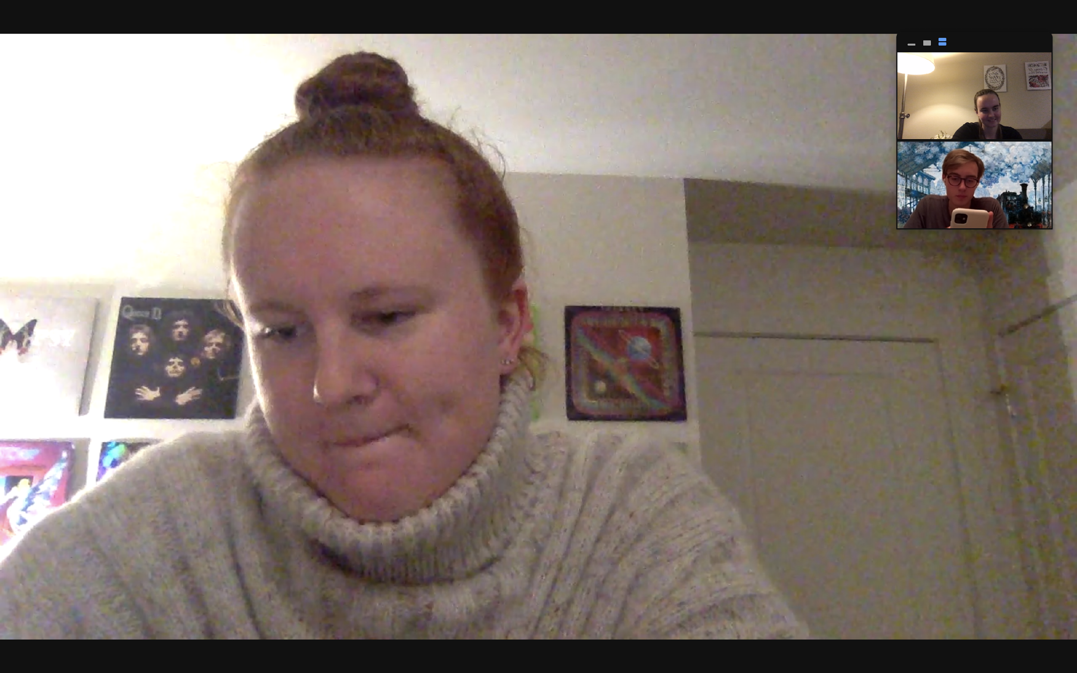
The texting begins...

Slide 45
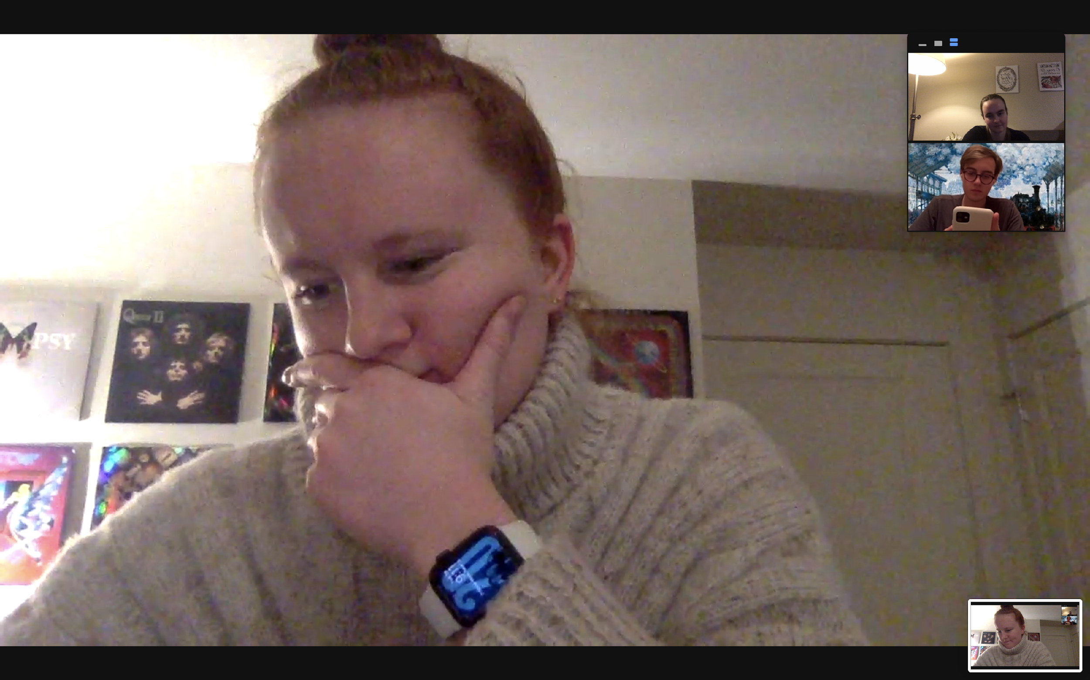
Negotiating..!

Slide 46
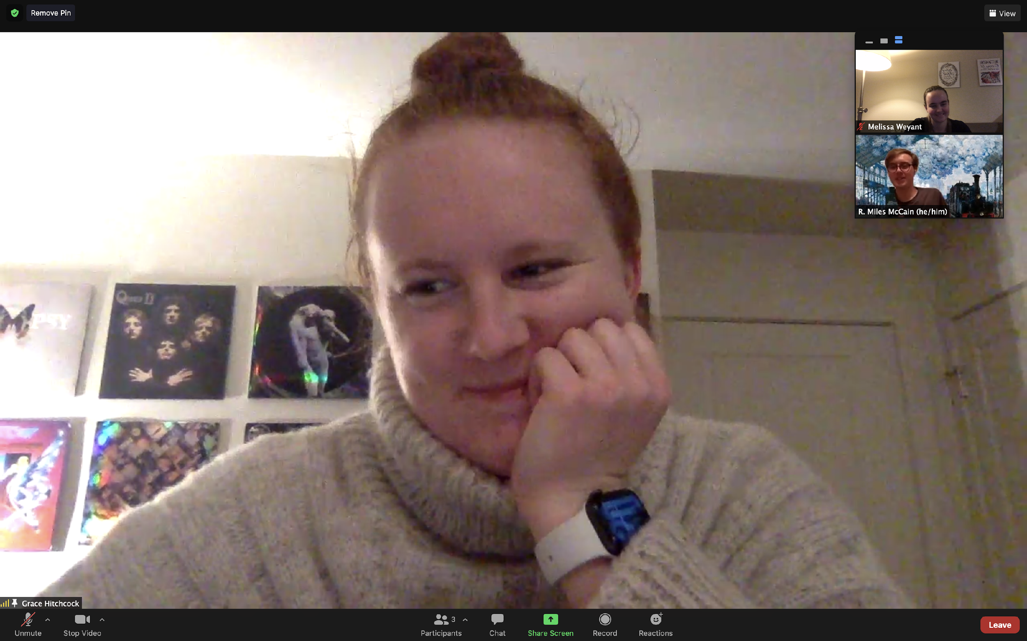
A deal has been made! Grace sold Miles her copy of “Make Russia Great Again” and some Christmas lights to help him with his lighting dilemma!

Slide 47
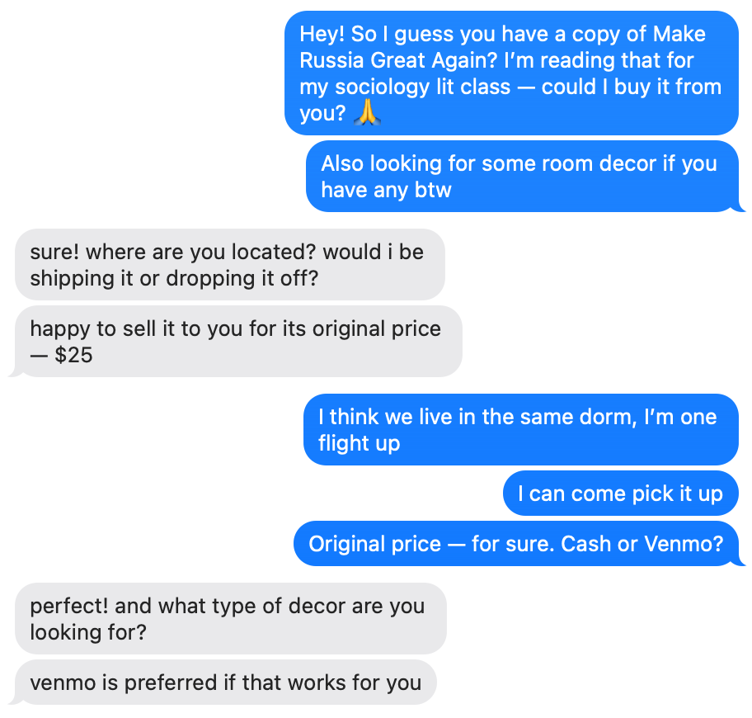
She’s willing to sell!

Slide 48
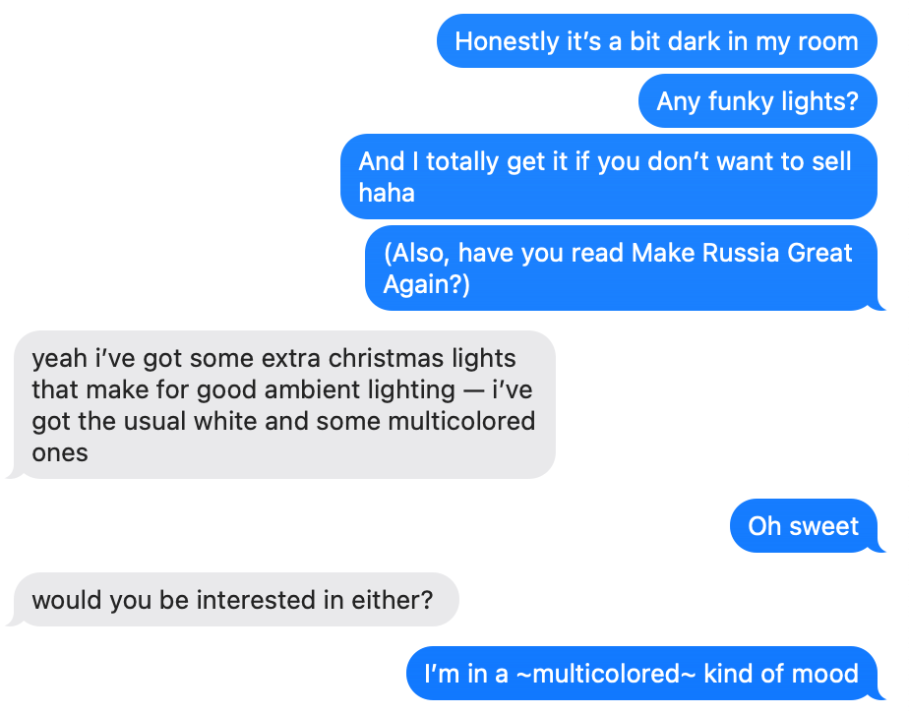
Miles didn’t even know what he wanted! Just “funky lights.”

Slide 49
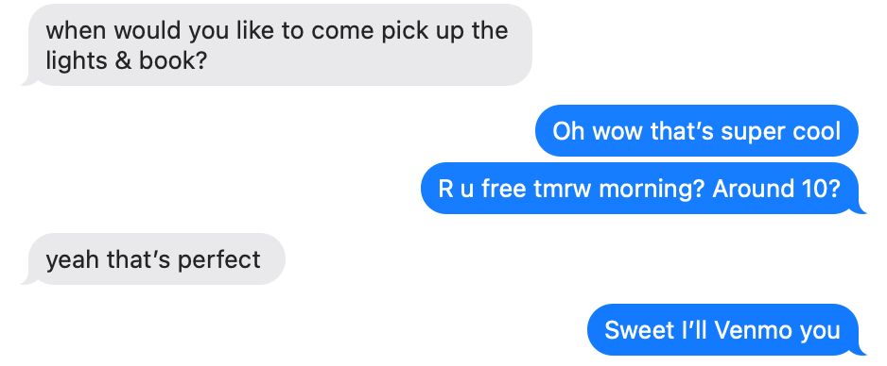

Slide 50
What worked
She has things she’s willing to sell, even though she wasn’t actively looking for a buyer.
A surprise benefit
Miles wasn’t sure exactly what he needed to brighten his room, but Grace suggested he buy her old string lights—a win win!

Slide 51
What didn’t work
Some items have sentimental value, and being asked to sell them can be unpleasant.
New learnings
Sellers who have items they’re willing to part with can help buyers who don’t know exactly what they need—for example, Grace suggesting string lights.

Slide 52
Grace
U.S. college student
“I think it’s a mutually beneficial situation — potentially more so than in a seller-centered marketplace. Knowing that I’m selling to someone who needs it and will make good use of it — there’s something satisfactory about it.”
“There’s a Yogi ball in my room that’s the bane of my existence. Every day I wake up and I’m like I should put this on eBay. But I haven’t yet.”

Slide 53
Assumptions validated
There were plenty of items lying around that she would be willing to sell, but she hadn’t put in the effort to list them online.
She was able to solve Miles’ general need for room decor in a way that was mutually beneficial.
New
assumptions
Potential sellers would reach out to buyers’ postings, even though it’s the buyers with the immediate need.
Notes:
We plan to incorporate automatic notifications for matchmaking, but the burden of outreach still would probably fall on sellers in this model.

Slide 54
HMW repackage thrifting so (Olivia’s) parents find it acceptable?
A subscription service where you receive used and/or thrifted items according to your responses to a short survey—a personalized “mystery box,” but used!

Slide 55
A subscription service where you receive used and/or thrifted items according to your responses to a short survey—a personalized “mystery box,” but used!
Assumption
The fun of a curated gift box exceeds the fun of just going to the thrift store yourself.

Slide 56
A subscription service where you receive used and/or thrifted items according to your responses to a short survey—a personalized “mystery box,” but used!
We wanted to know
whether the gift would be fun.
We set up
a real-life mystery box of used items!

Slide 57
A subscription service where you receive used and/or thrifted items according to your responses to a short survey—a personalized “mystery box,” but used!
Clothing size
small/medium, shoes size 9
Favorite color
blue
Favorite 1900’s decade
the 20’s

Slide 58
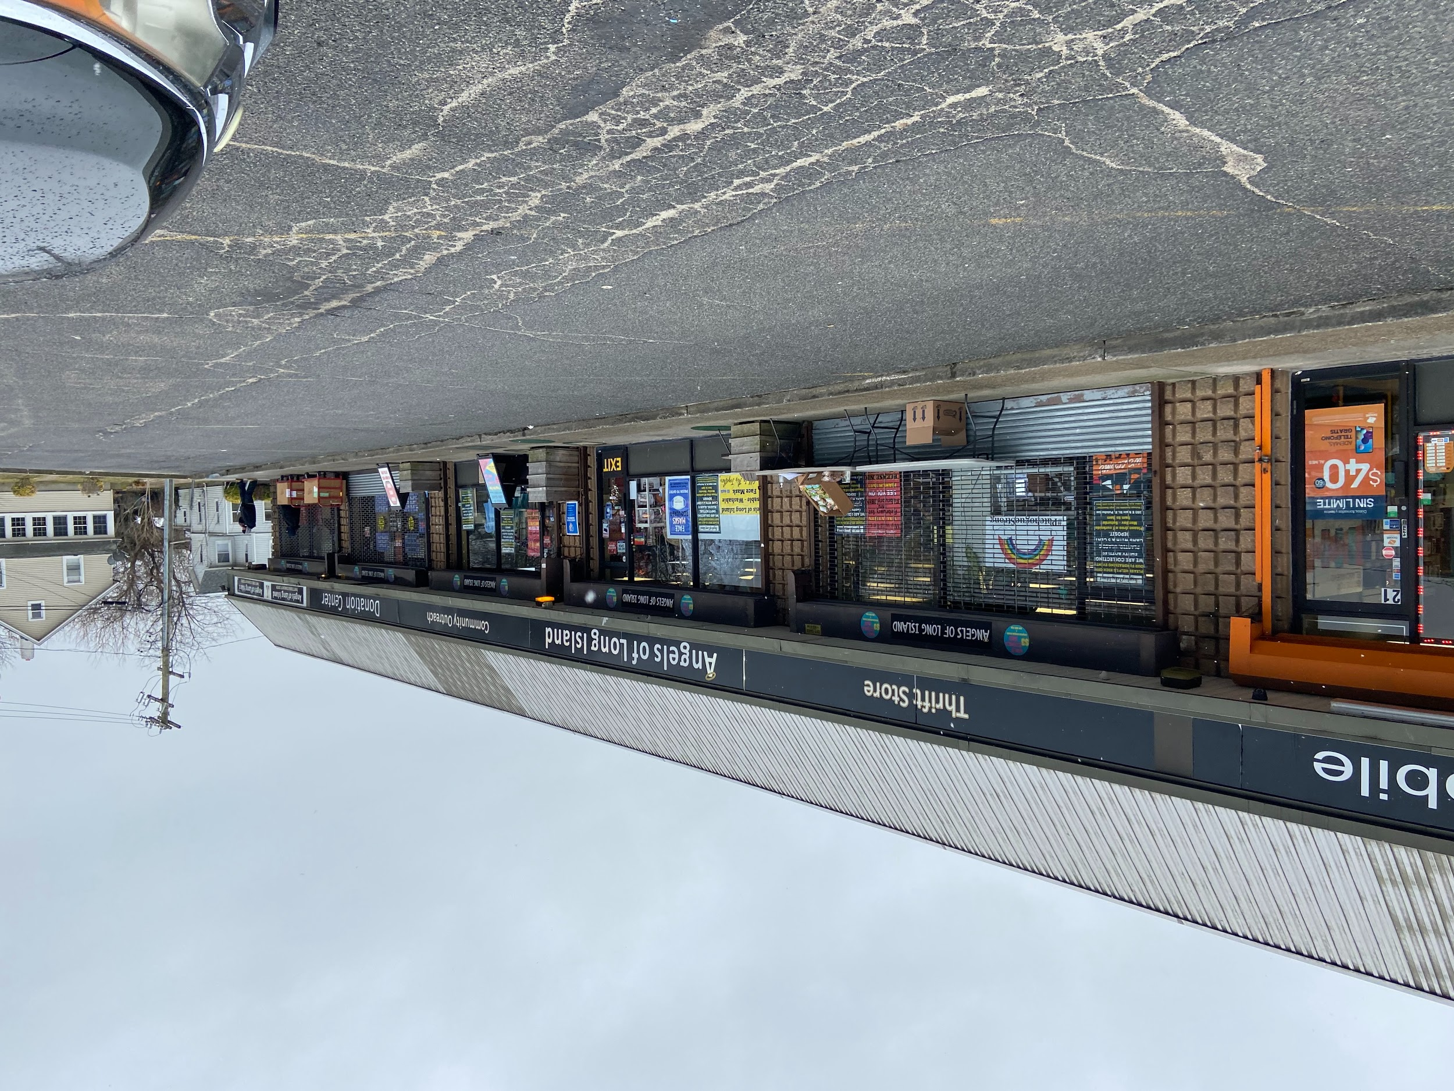
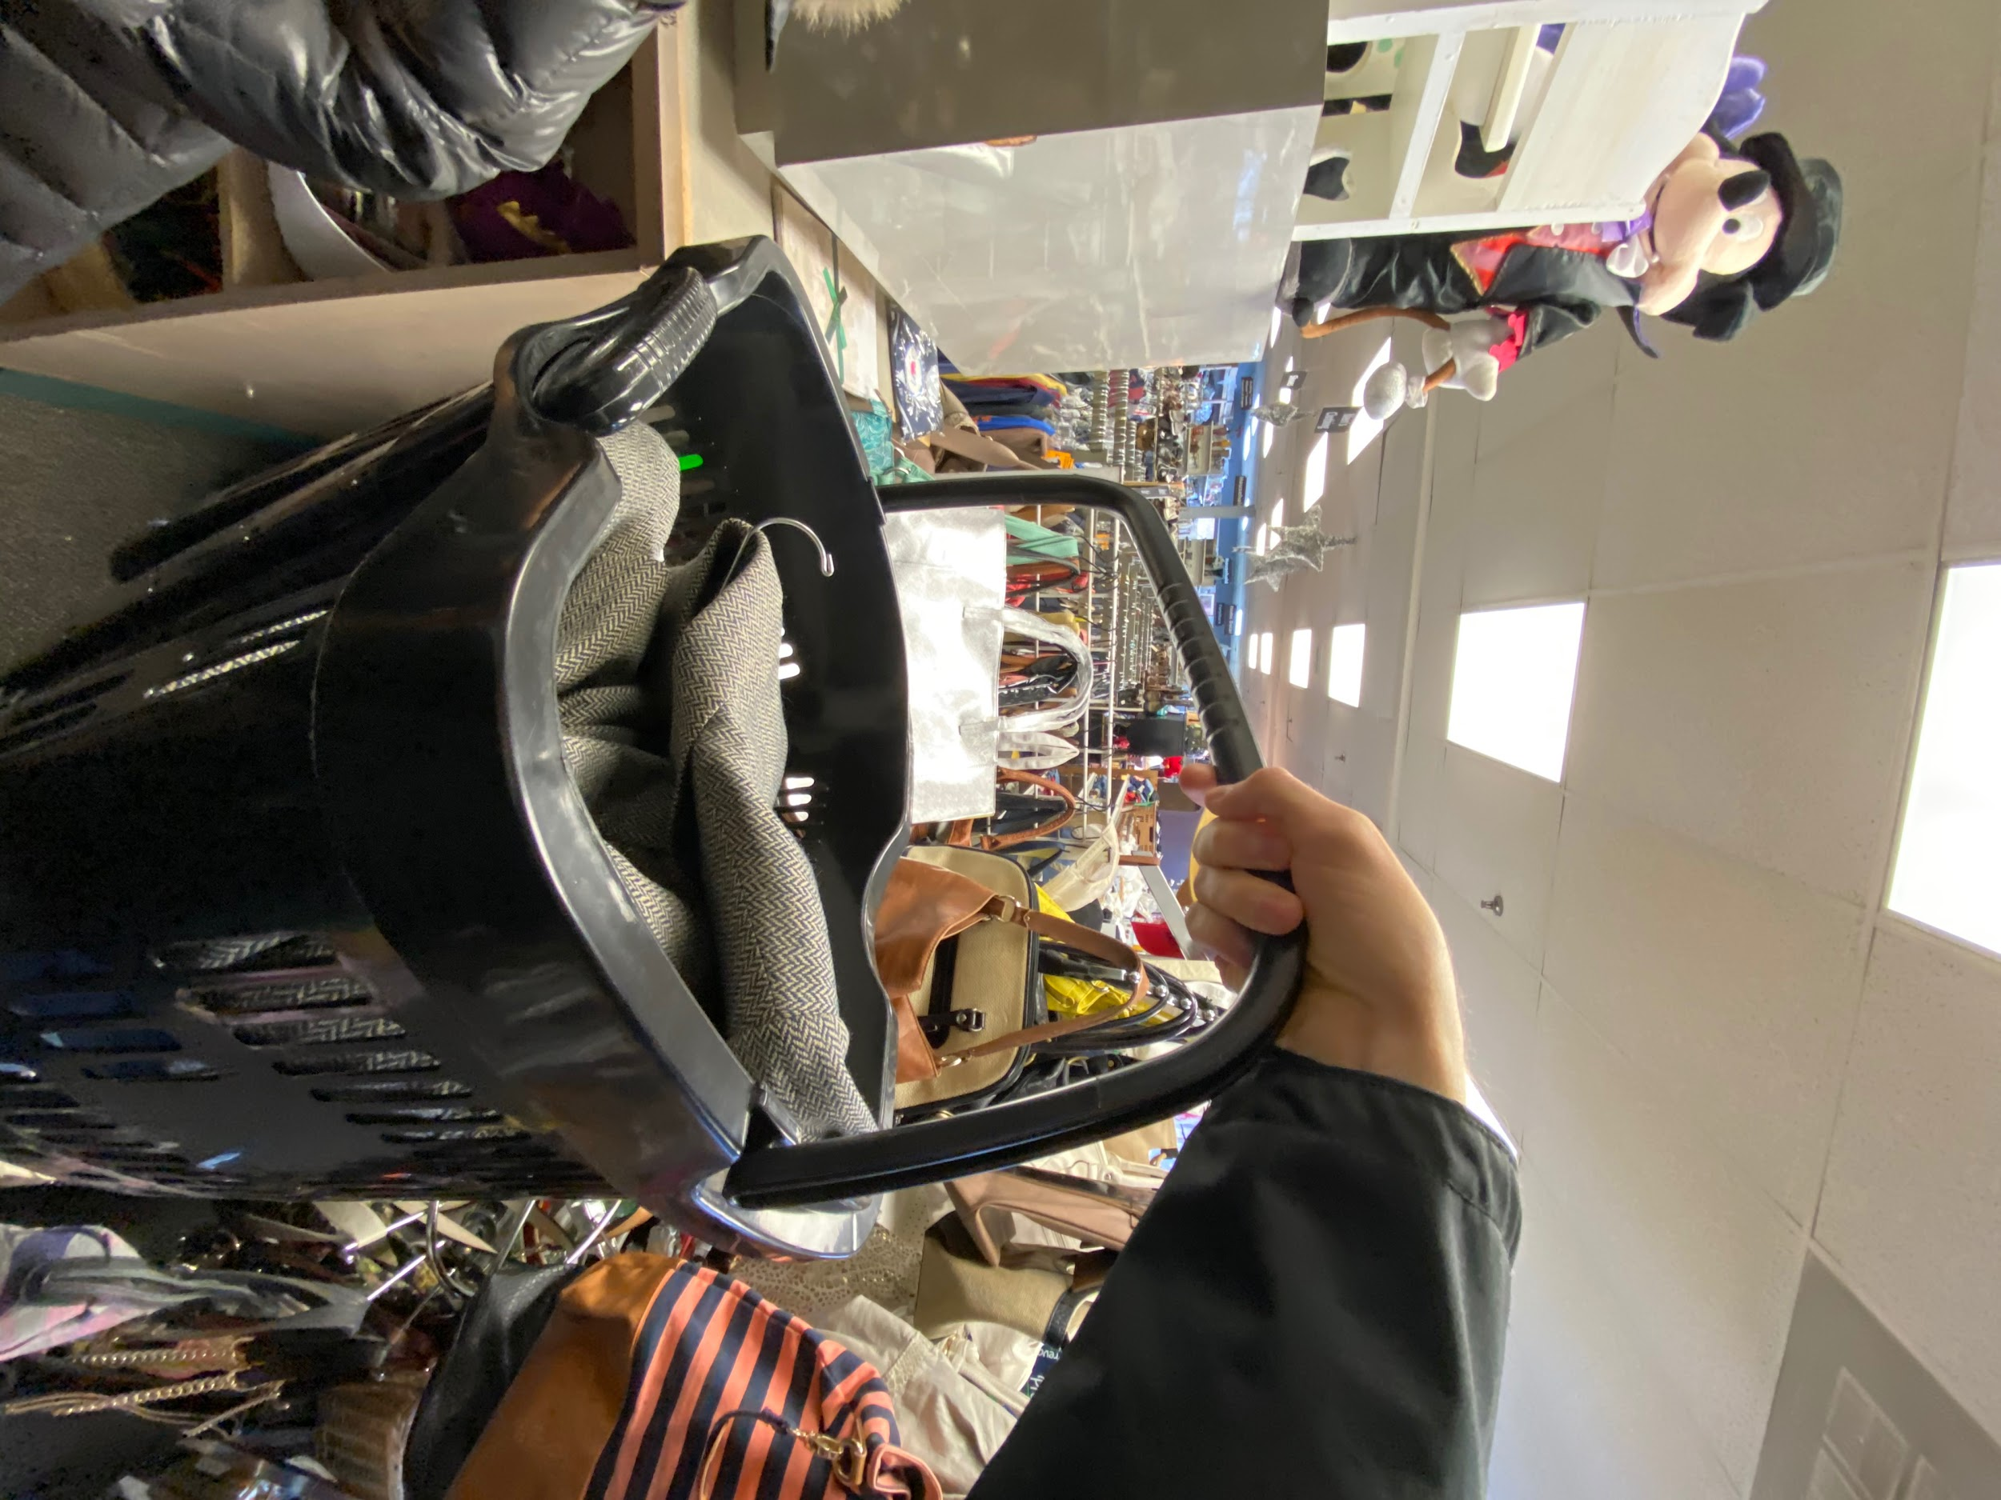

Slide 59
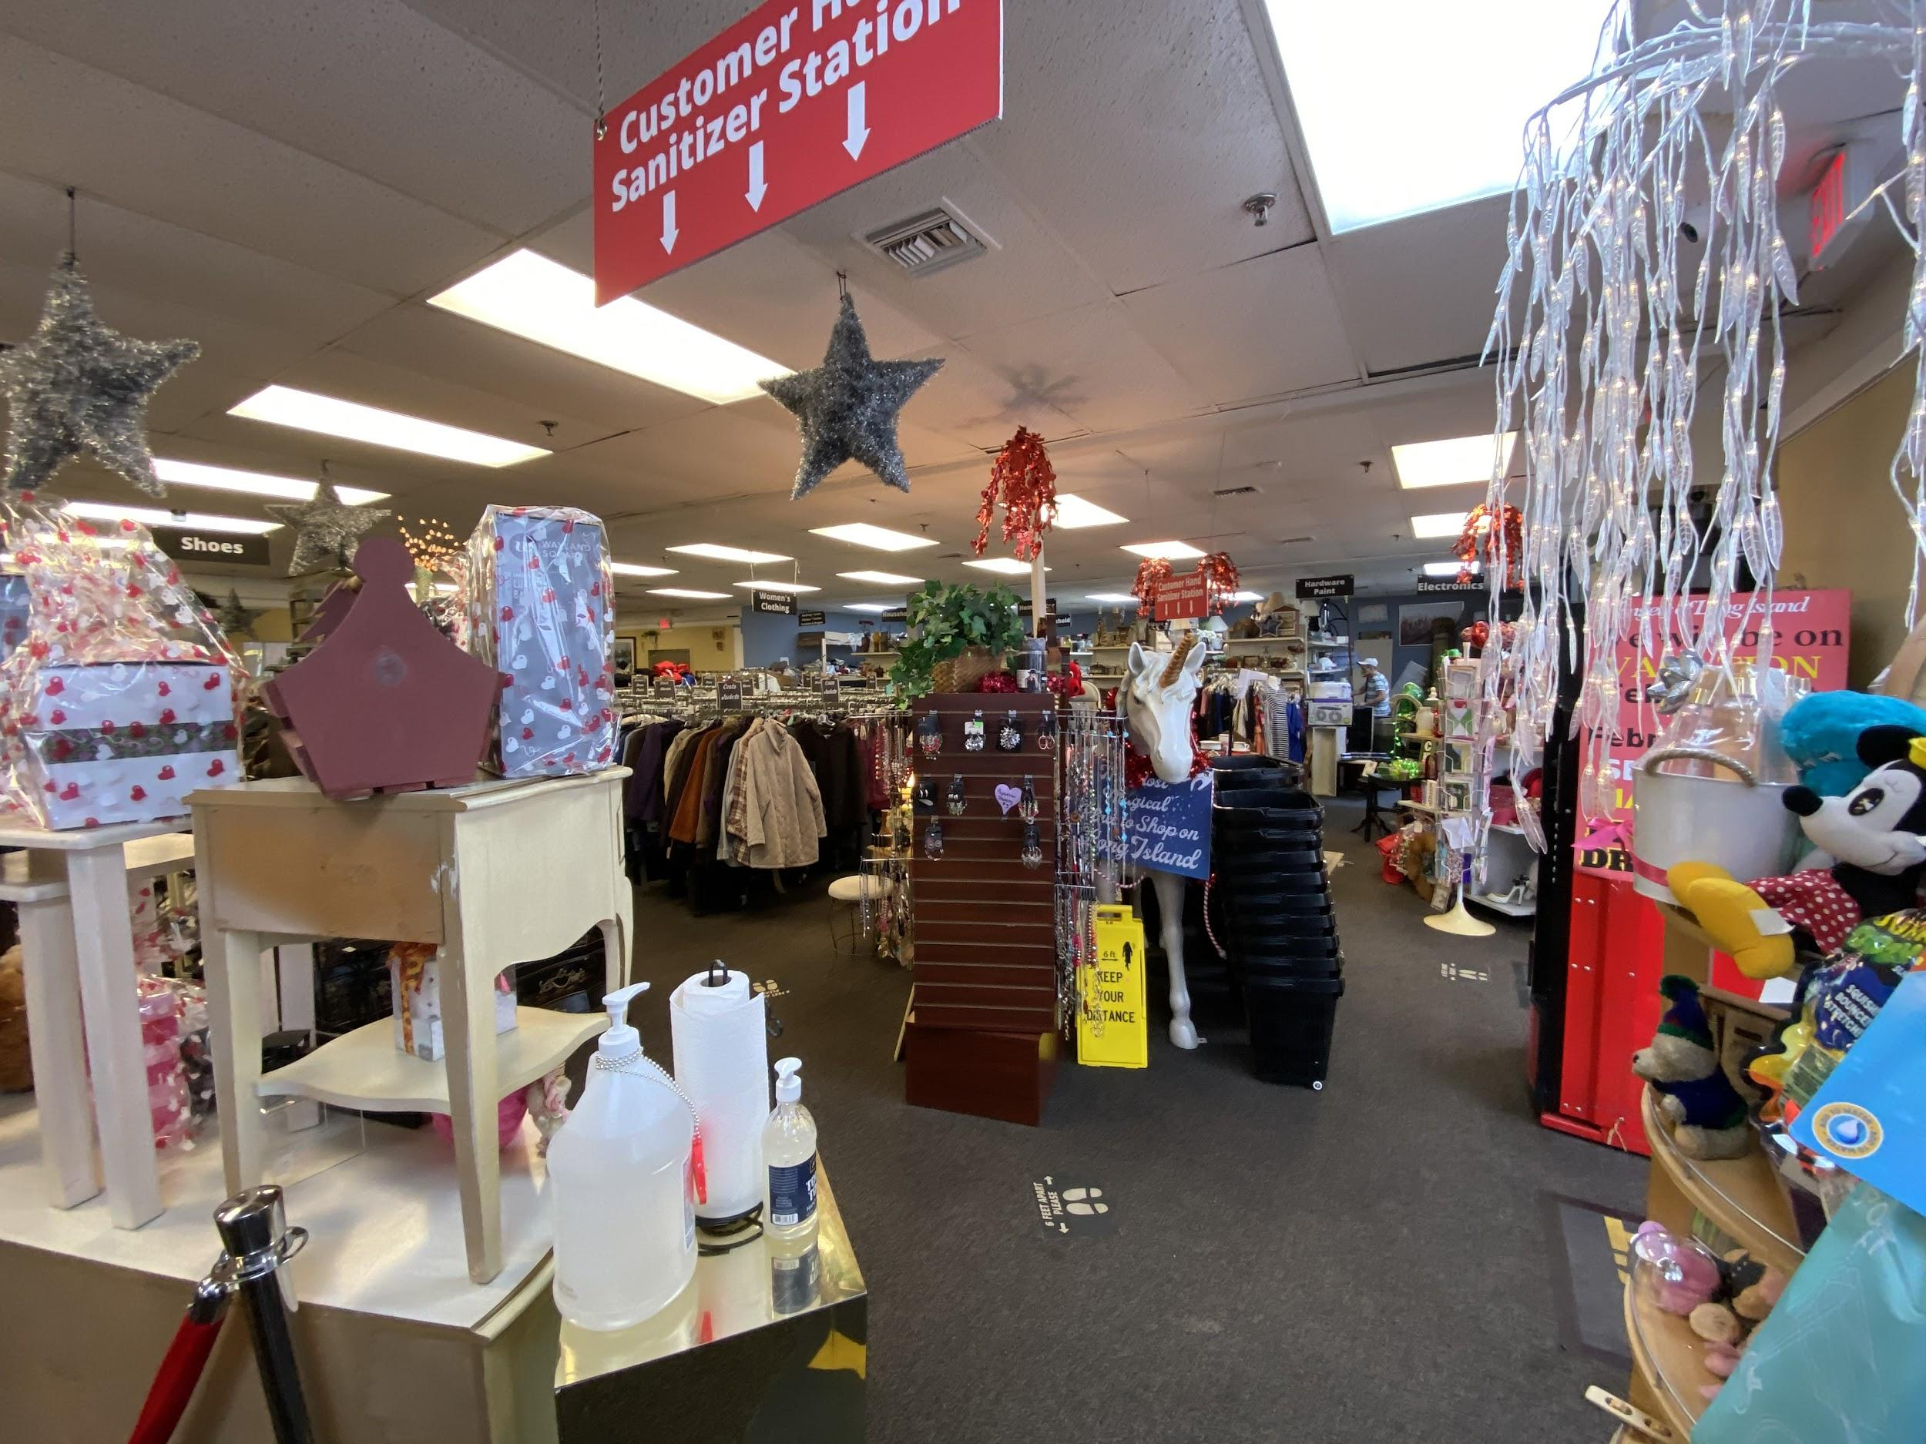

Slide 60
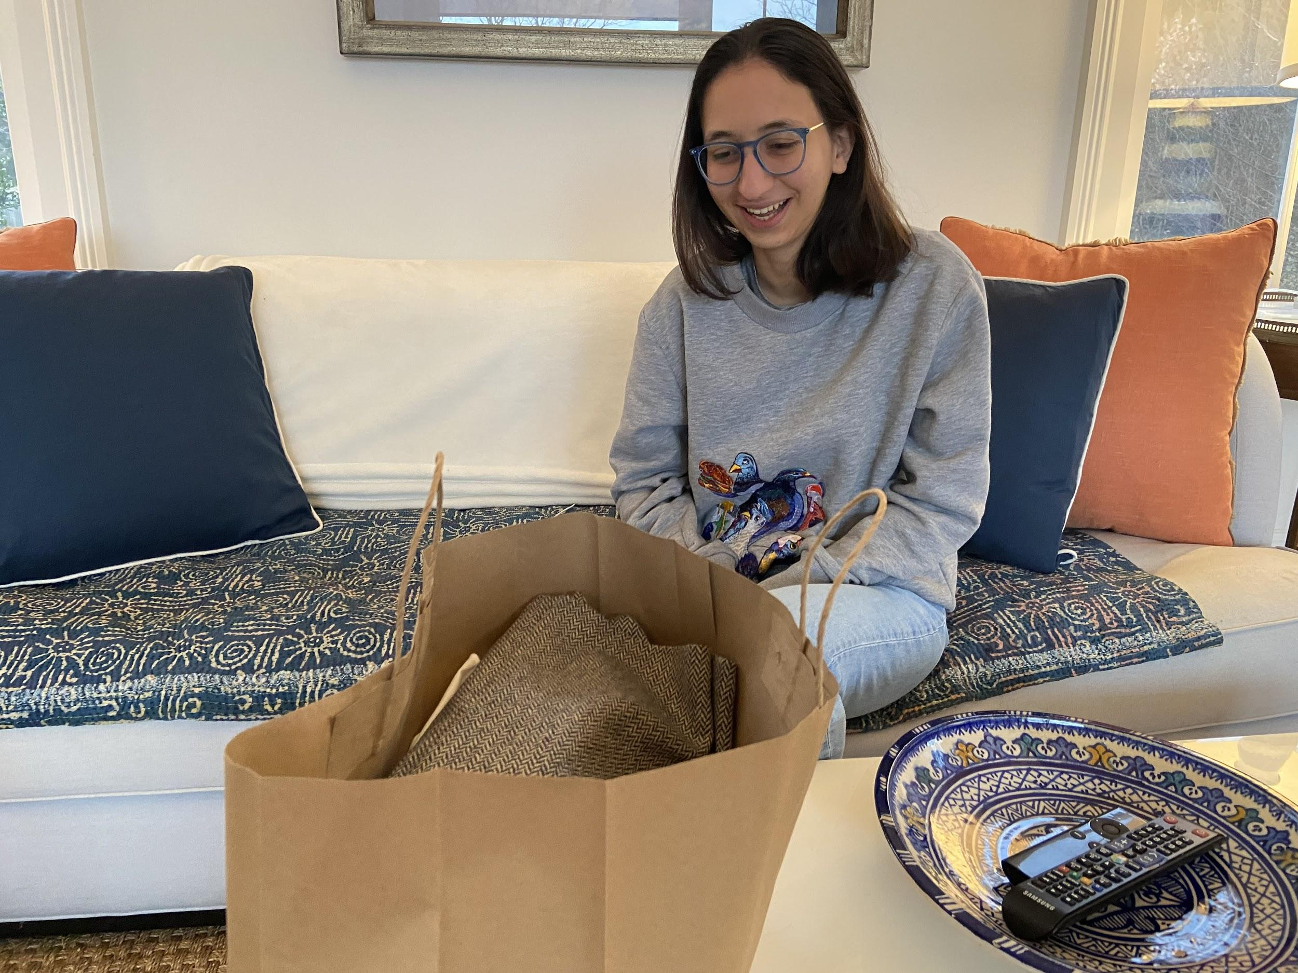
The reveal!

Slide 61
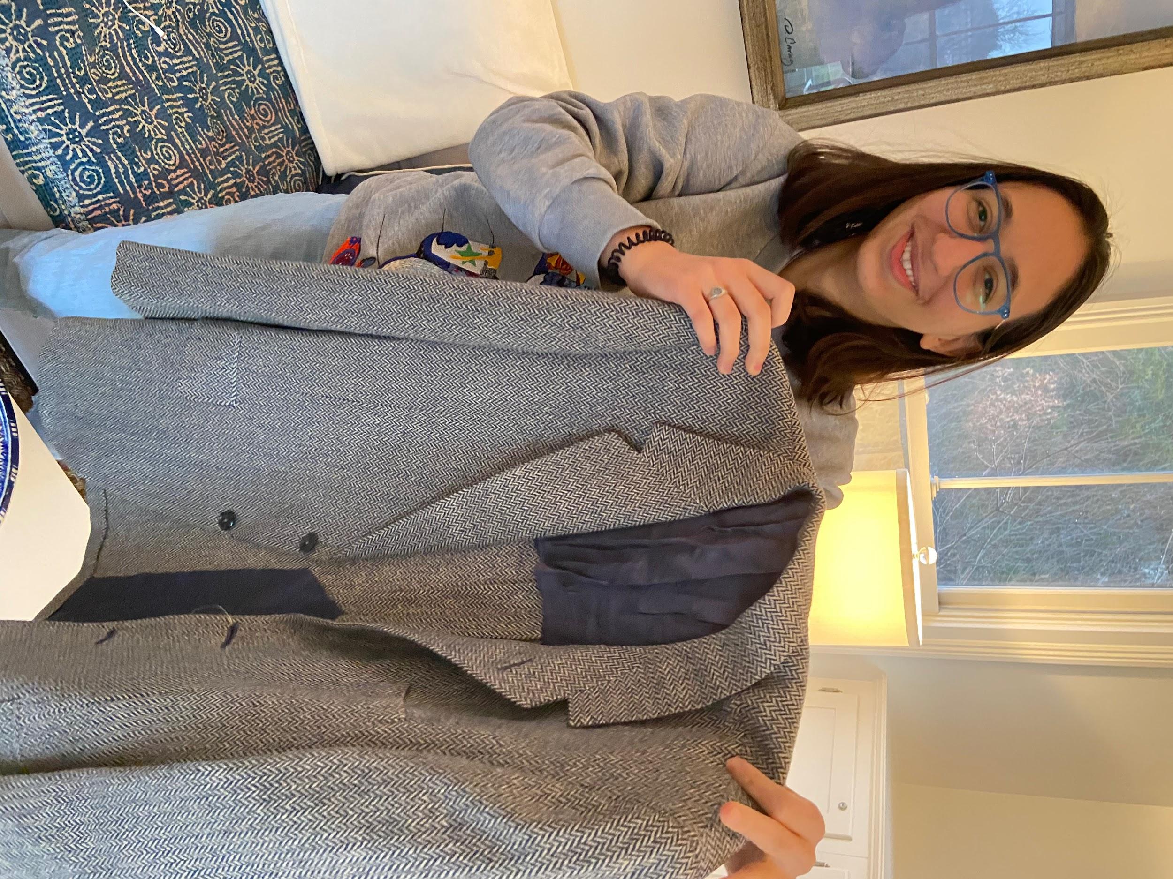
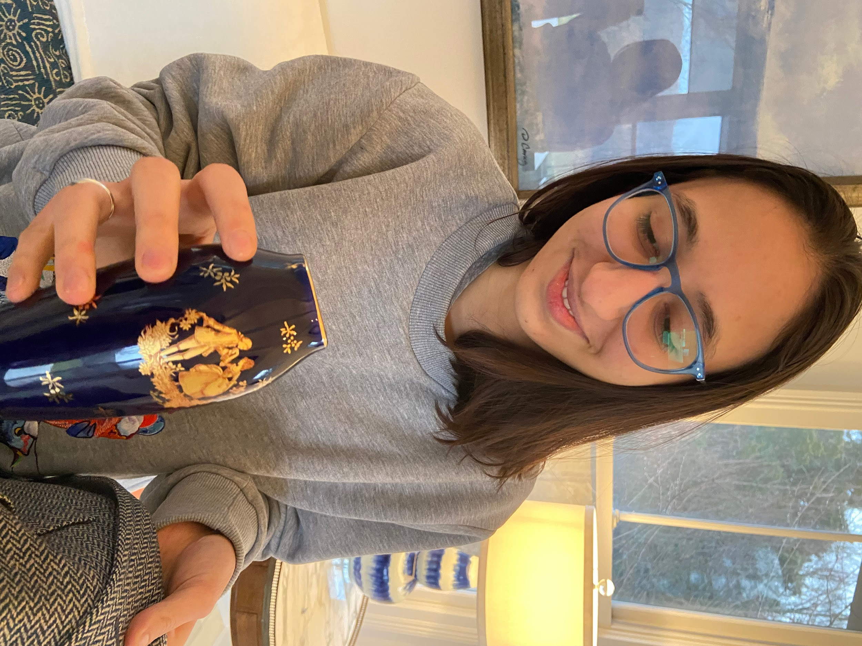

Slide 62
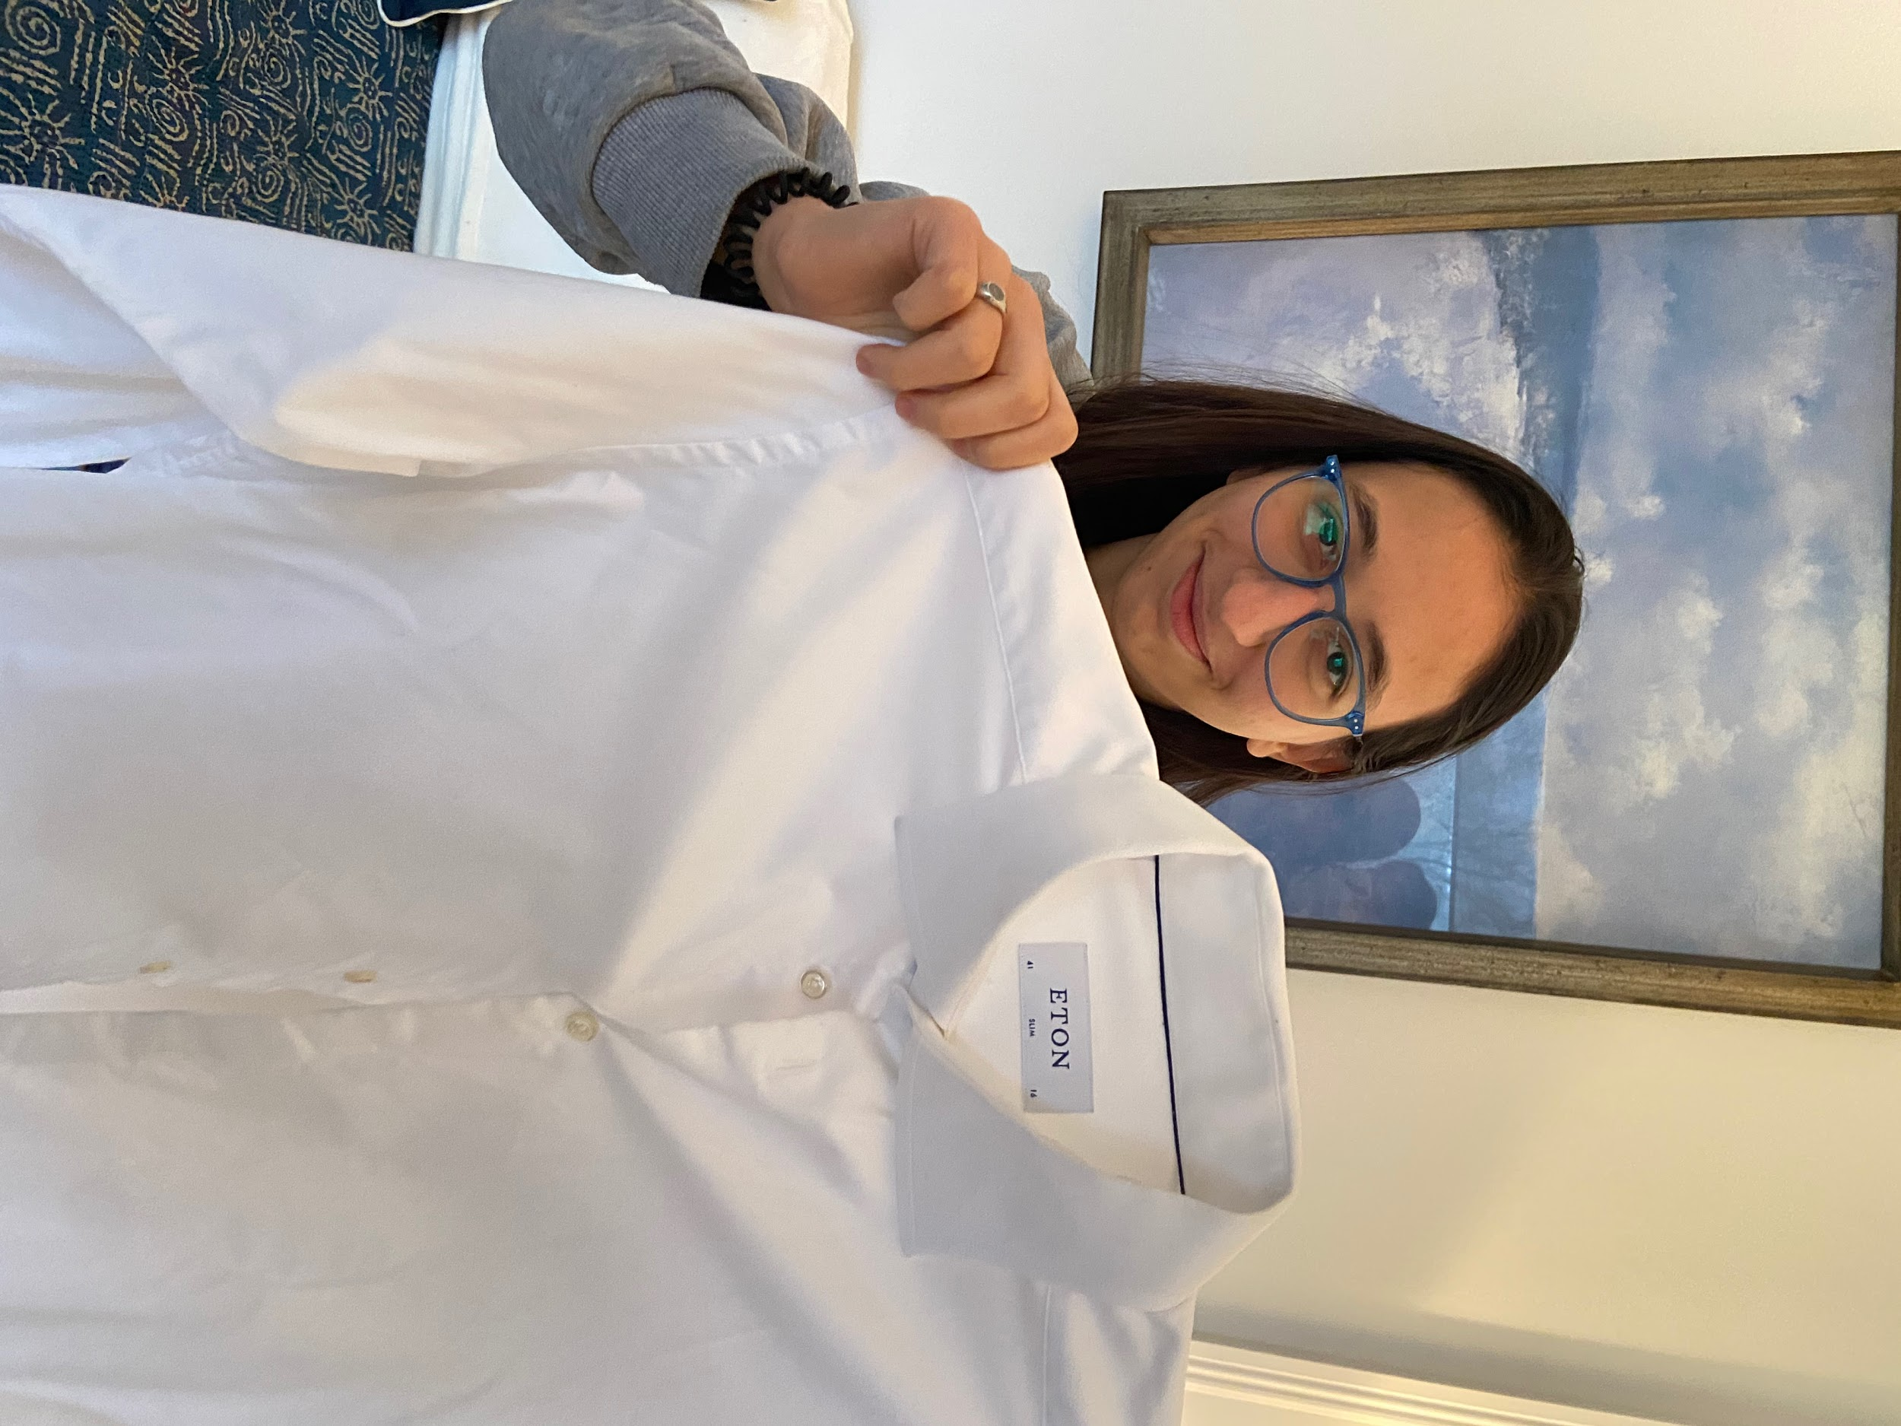
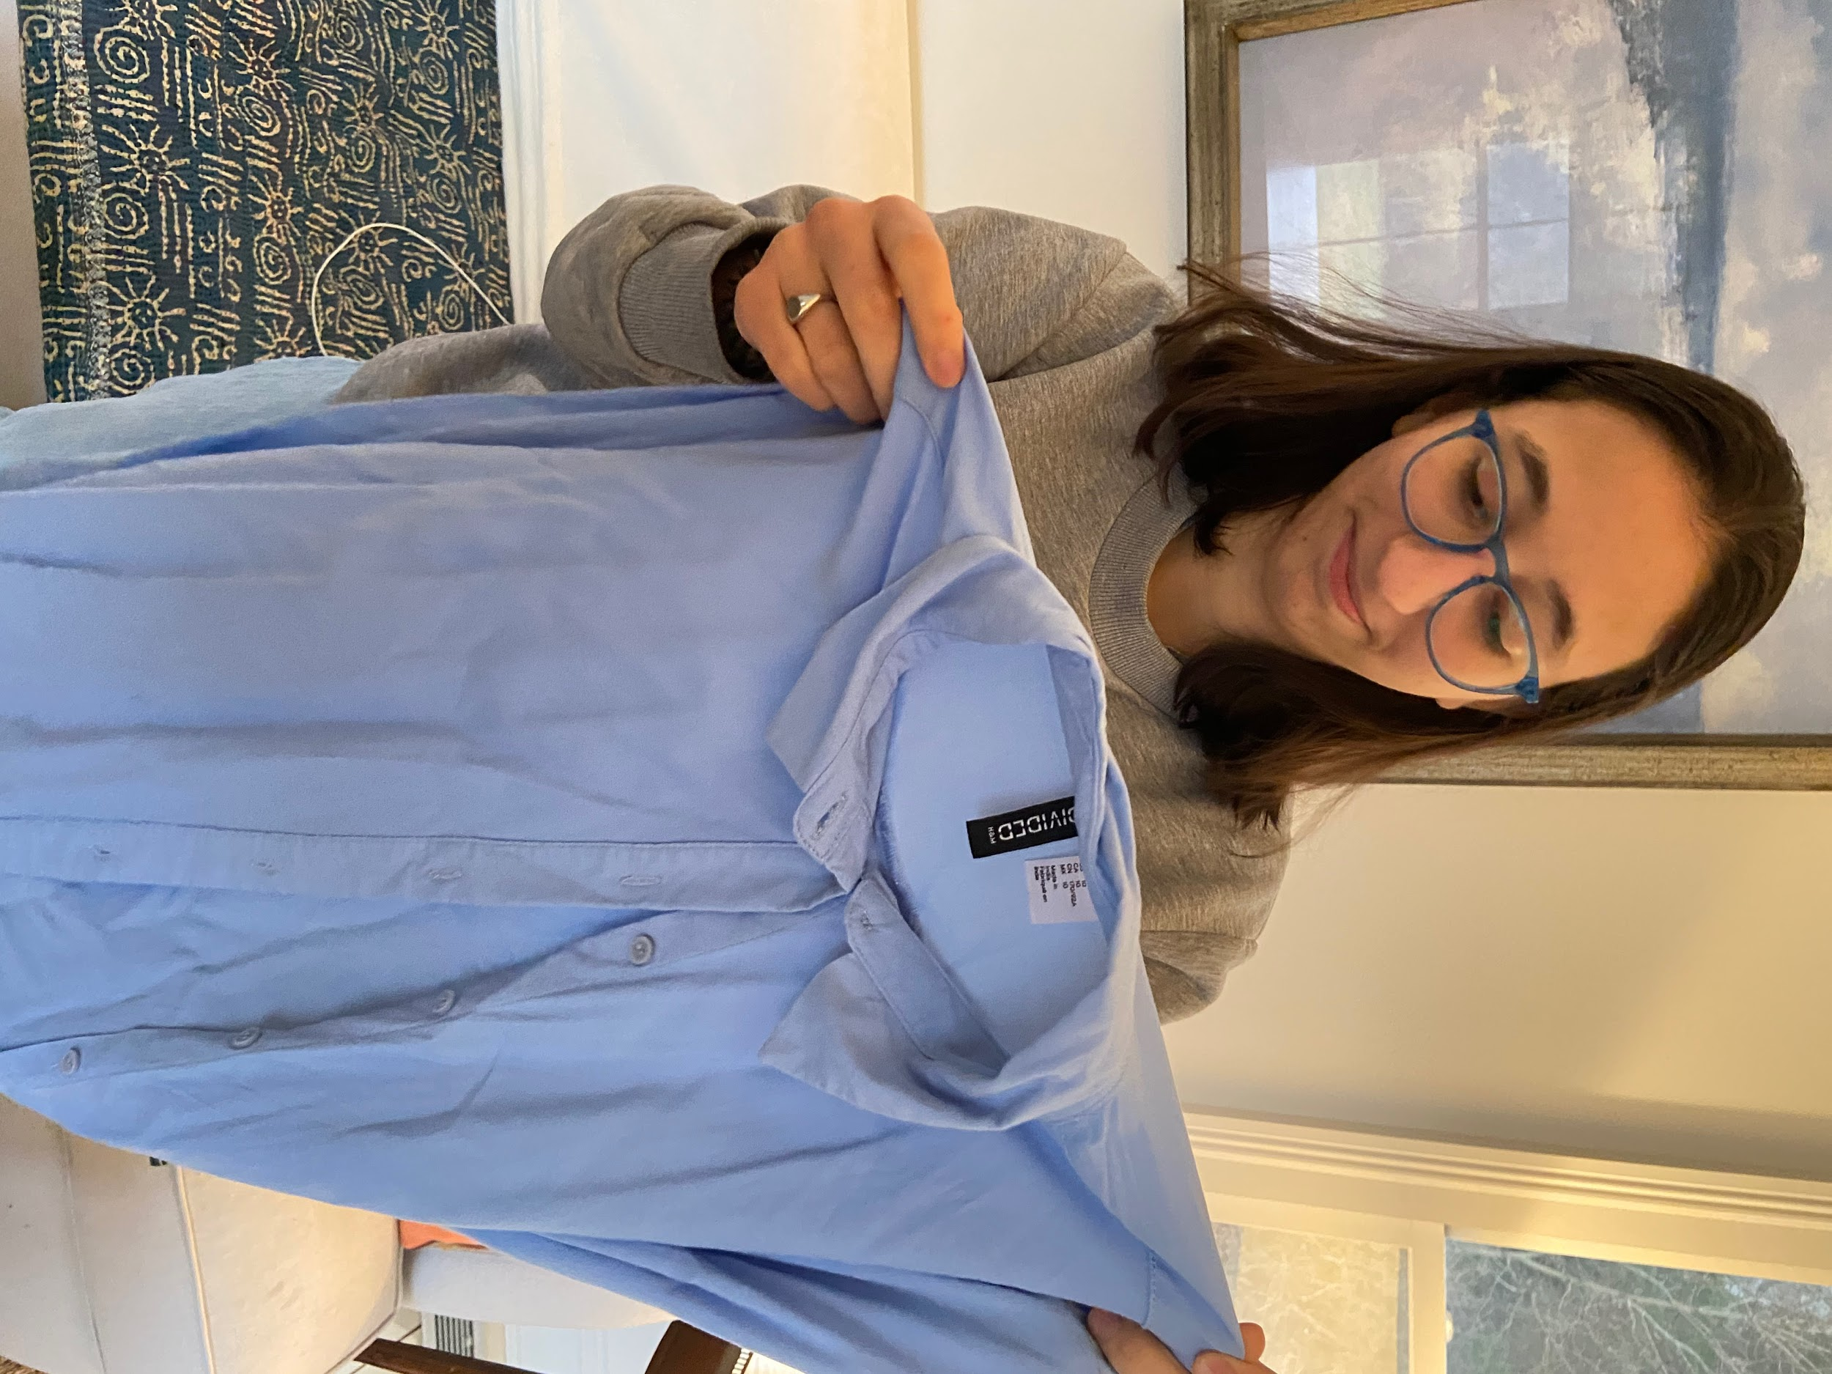

Slide 63
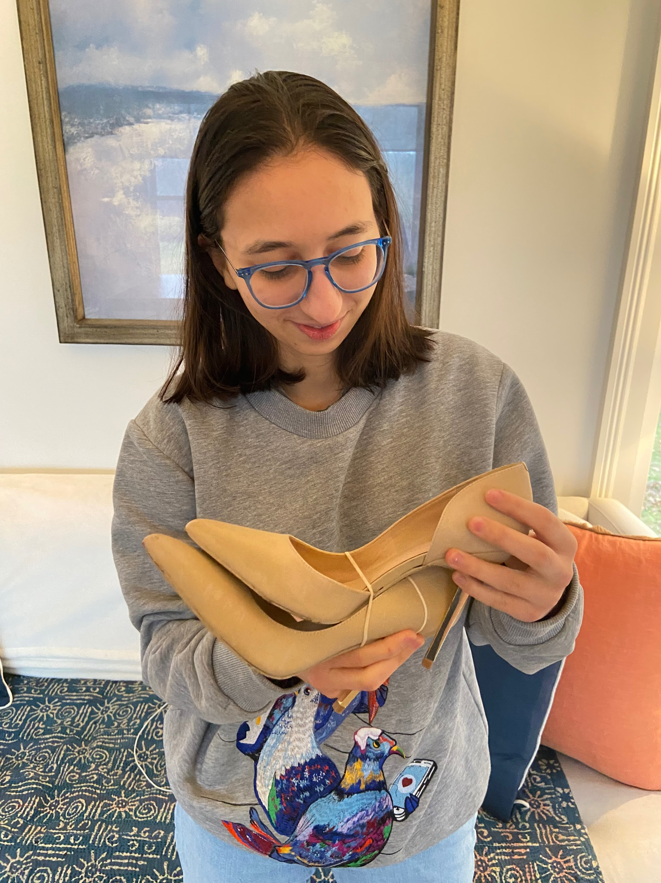

Slide 64
What worked
Selecting items that matched her preferences went smoothly.
Surprises
$15 was more than enough to put together a large gift box, at least at Miles’ local thrift store.
Thrift stores have bulk discounts, so if this were a real-world service, the $15 would stretch even farther.

Slide 65
What didn’t work
She wasn’t interested in keeping most of the items. It was all just novelty.
New learnings
Thrift stores already have an element of surprise, but leave you in control. Our service wouldn’t.

Slide 66
Isabelle
Stanford student
“It felt like a disappointing birthday as a kid.”

Slide 67
Assumptions invalidated
There was an element of surprise, but there’s an element of surprise at thrift stores as well.
She didn’t want to keep most of the items in her mystery box.
Plus...
This solution is not interface-driven.

Slide 68

Best solution...

Slide 69

The reverse marketplace

Slide 70
Why?
It solves multiple needs:
It’s novel. We’ve never seen a formal reverse marketplace.
No shipping (our HMW)
Unlocks hidden supply for buyers
Eliminates sellers’ need to explicitly list all items
Supports buyers who don’t know exactly what they need
It’s interface-driven. It could be a web platform or app.

Slide 71
Summary
Our 1st and 2nd prototypes had the most satisfying results.
Our 1st prototype—expiration discounts—would require buy-in from grocery stores; further testing and interviews are needed here.
Our 2nd prototype—the reverse marketplace—had the most enthusiastic response.
Our 3rd prototype—the mystery box—was a dud. “Disappointing birthday.”
Item transparency emerged as a key issue across prototypes.
We think our 2nd prototype is the right direction going forward.

Slide 72
Appendix: Michelle’s HMWs
HMW encourage local pickups and exchanges?
HMW make face-to-face exchanges more convenient?
HMW make local pickups faster and less time consuming than shipping?
HMW build well-stocked local trading economies?
HMW make buying items from far away unnecessary?
HMW adjust expectations so that local pickups are the default?

Slide 73
Appendix: Olivia’s HMWs
HMW repackage thrifting so her parents find it acceptable?
HMW make thrifting cleaner?
HMW get parents involved in thrifting themselves?
HMW make thrifting more trendy?
HMW make thrifting feel like an ecological necessity?
HMW make other people less judgemental about thrifting?

Slide 74
Appendix: Dan’s HMWs
HMW redistribute grocery store waste that is still usable?
HMW repurpose excess items into other new products?
HMW make sure everything gets bought before it’s thrown away?
HMW encourage consumers to buy items about to be thrown out?
HMW eliminate surplus inventory?
HMW make waste more useful?

